Slide 1
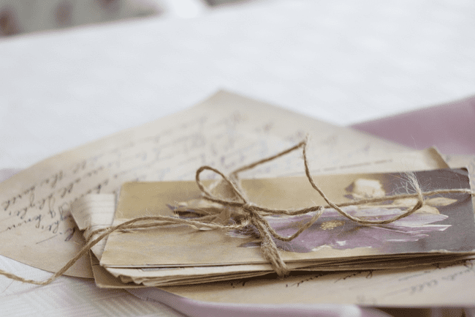
Letters!
Notes:
Image of letters, free for use under the Pixabay Content License

Slide 2

Aims:
To read and understand letters written in the 18th century (or 1700s)
To write our own letter
To compare communication in the past and present
Notes:
Portrait of a boy, British eighteenth century; https://www.mutualart.com/Artwork/Portrait-of-a-boy--half-length--in-a-whi/52FF99DC71A7C835
Young Woman Writing a Letter, Pietro Antonio Rotari (Italian, 1707-1762), c. 1755-60

Slide 3
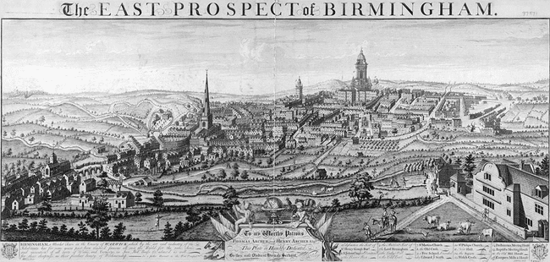
Notes:
The East Prospect of Birmingham (1732), engraving by William Westley (Wikimedia Commons, public domain) https://commons.wikimedia.org/wiki/File:Westley---East-Prospect-of-Birmingham-1732.jpg

Slide 4
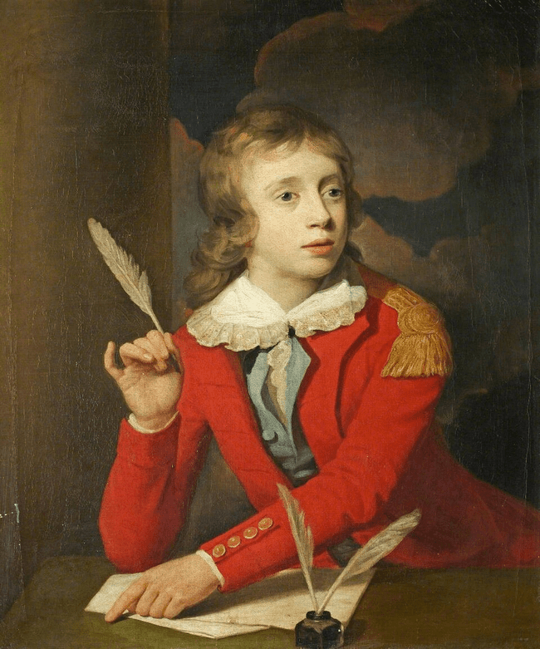
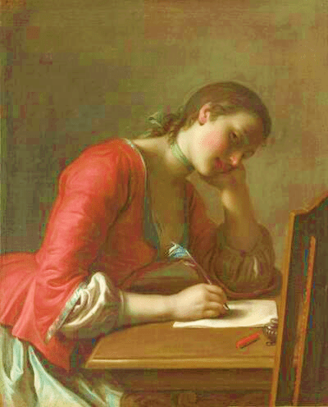
Notes:
‘Henry Hoare (1784–1836), Son of Sir Richard Colt Hoare, as a Boy, Writing a Letter’, by Samuel Woodforde, 732202 - National Trust (Wikimedia Commons, public domain) https://commons.wikimedia.org/wiki/File:Samuel_Woodforde_(1763-1817)_-_Henry_Hoare_(1784%E2%80%931836),_Son_of_Sir_Richard_Colt_Hoare,_as_a_Boy,_Writing_a_Letter_-_732202_-_National_Trust.jpg
'Young Girl Writing a Love Letter' by Pietro Antonio Rotari, Norton Simon Museum (Wikimedia Commons, public domain) https://commons.wikimedia.org/wiki/File:%27Young_Girl_Writing_a_Love_Letter%27_by_Pietro_Antonio_Rotari,_Norton_Simon_Museum.JPG

Slide 5
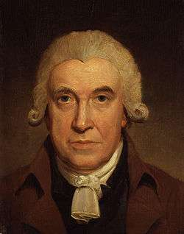
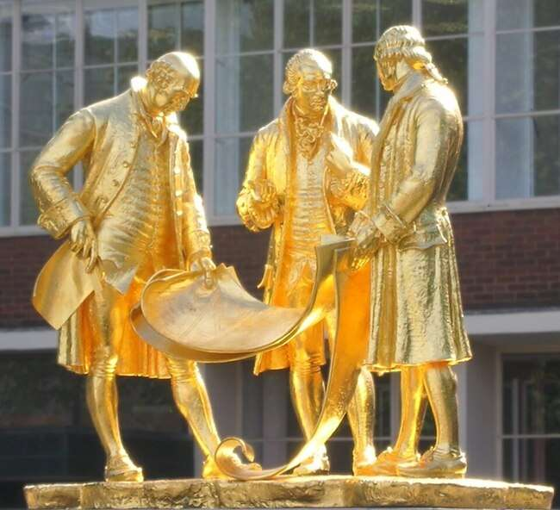
James Watt:
engineer and scientist
Notes:
Image of statue of Boulton, Watt and Murdoch, Oosoom at English Wikipedia (Wikimedia Commons, licensed under the Creative Commons Attribution-Share Alike 3.0 Unported license) https://commons.wikimedia.org/wiki/File:Boulton,_Watt_and_Murdoch.jpg
Portrait of James Watt by Henry Howard, National Portrait Gallery, London (Wikimedia Commons, public domain) https://commons.wikimedia.org/wiki/File:James_Watt_by_Henry_Howard.jpg

Slide 6
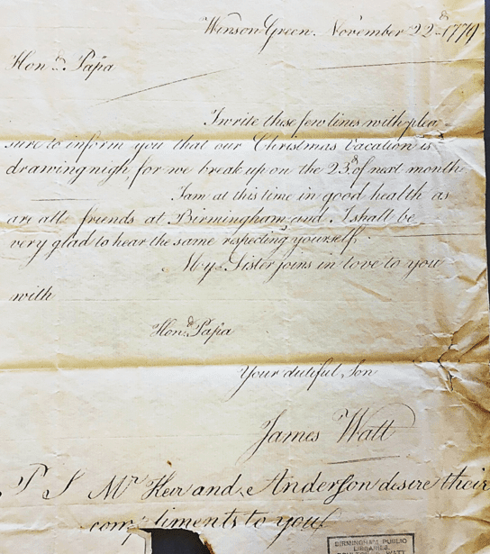


Slide 7
Winson Green. November 22^{d} 1779
Hon^{d} Papa
I write these few lines with plea-
sure to inform you that our Christmas Vacation is
drawing nigh, for we break up on the 23^{d} of next month
I am at this time in good health as
are all friends at Birmingham and I shall be
very glad to hear the same respecting yourself.
My Sister joins in love to you
Hon^{d} Papa
Your dutiful Son
James Watt
P. S. M^{r} Kerr and Anderson desire their
compliments to you

Slide 8

What is James’ purpose? (Why is he writing?)
How would you describe his relationship with his father?
Who are Mr Kerr and Mr Anderson?

Slide 9
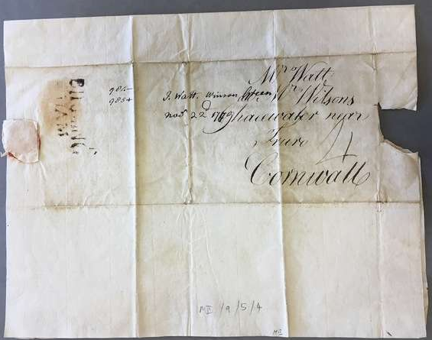

Slide 10
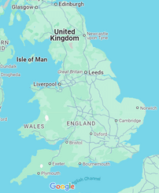
Notes:
Google Maps, Map data ©2025 Google
https://about.google/brand-resource-center/products-and-services/geo-guidelines/#required-attribution

Slide 11

Your turn!
Imagine you are James Watt Sr.
Write a short reply to your son’s letter:
  How will you begin? (Remember the place and date!)
  How are you feeling?
  What do you want to say?
  How will you end the letter?

Slide 12
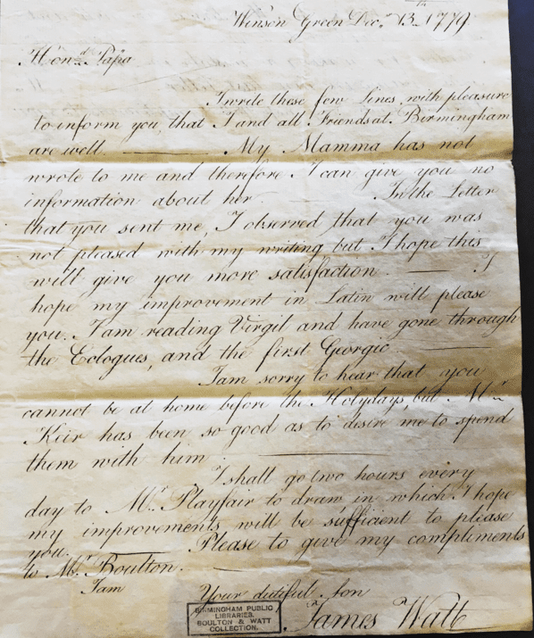

Slide 13
Winson Green Dec^{r} 13th 1779
Hon^{d} Papa
I write these few Lines with pleasure
to inform you that I and all Friends at Birmingham
are well. - My Mamma has not
wrote to me and therefore I can give you no
information about her. - In the Letter
that you sent me, I observed that you was
not pleased with my writing but I hope this
will give you more satisfaction. - I
hope my improvement in Latin will please
you […]
I am sorry to hear that you
cannot be at home before the Holydays, but M^{r}
Kerr has been so good as to desire me to spend
them with him. -
I shall go two hours every
day to M^{r} Playfair to draw, in which I hope
my improvements will be sufficient to please
you. - Please to give my compliments
To M^{r} Boulton. -
I am
Your dutiful Son
James Watt

Slide 14
How have James’ plans changed?
What subjects is James studying at school?
Can you find any strange spellings or grammar?

Slide 15
How do letters compare with phone calls, texts and social media?
Are there any benefits to letters?
Notes:
‘Henry Hoare (1784–1836), Son of Sir Richard Colt Hoare, as a Boy, Writing a Letter’, by Samuel Woodforde, 732202 - National Trust (Wikimedia Commons, public domain) https://commons.wikimedia.org/wiki/File:Samuel_Woodforde_(1763-1817)_-_Henry_Hoare_(1784%E2%80%931836),_Son_of_Sir_Richard_Colt_Hoare,_as_a_Boy,_Writing_a_Letter_-_732202_-_National_Trust.jpg

